Slide 1
Chapter 2
Network Models

Slide 2
2-1 LAYERED TASKS
We use the concept of layers in our daily life. As an example, let us consider two friends who communicate through postal mail. The process of sending a letter to a friend would be complex if there were no services available from the post office.
Topics discussed in this section:
Sender, Receiver, and Carrier Hierarchy

Slide 3
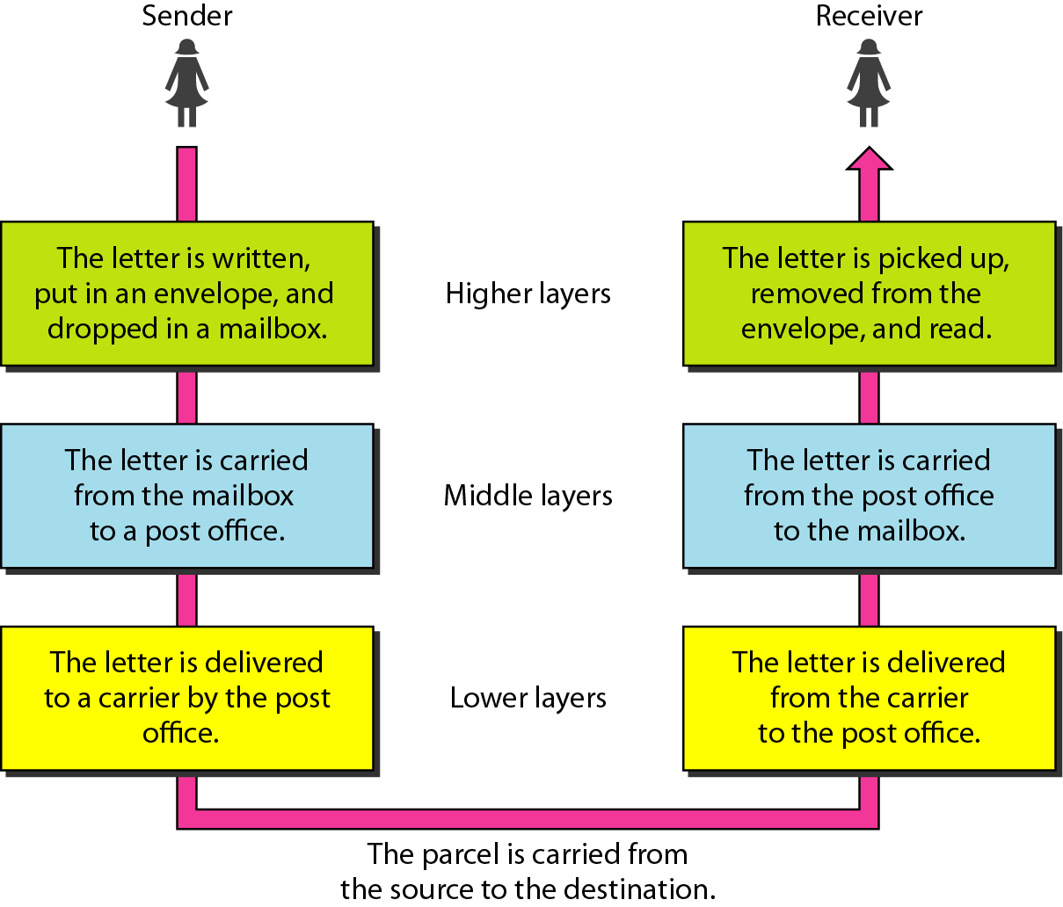
Figure 2.1 Tasks involved in sending a letter [1]

Slide 4
2-2 THE OSI MODEL
Established in 1947, the International Standards Organization (ISO) is a multinational body dedicated to worldwide agreement on international standards. An ISO standard that covers all aspects of network communications is the Open Systems Interconnection (OSI) model. It was first introduced in the late 1970s.
Topics discussed in this section:
Layered Architecture Peer-to-Peer Processes
Encapsulation

Slide 5

Note
ISO is the organization. OSI is the model.

Slide 6
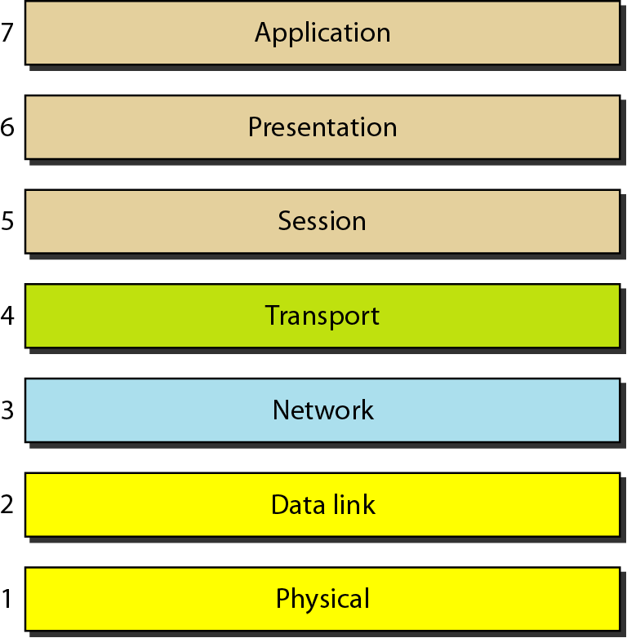
Figure 2.2 Seven layers of the OSI model [1]

Slide 7
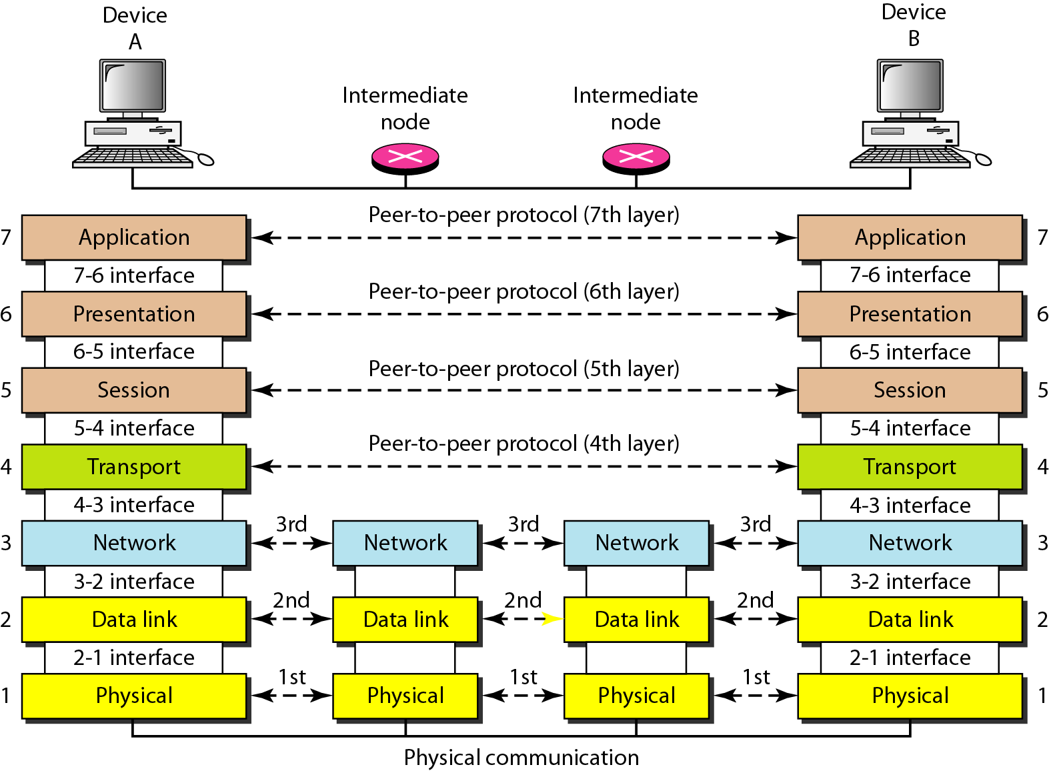
Figure 2.3 The interaction between layers in the OSI model [1]

Slide 8
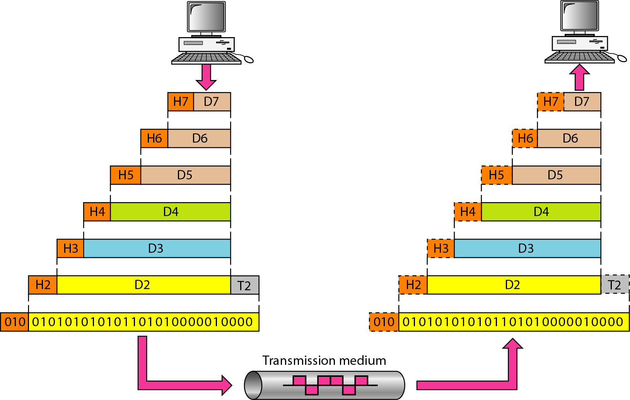
Figure 2.4 An exchange using the OSI model [1]

Slide 9
2-3 LAYERS IN THE OSI MODEL
In this section we briefly describe the functions of each layer in the OSI model.
Topics discussed in this section:
Physical Layer Data Link Layer
Network Layer
Transport Layer
Session Layer
Presentation Layer
Application Layer

Slide 10
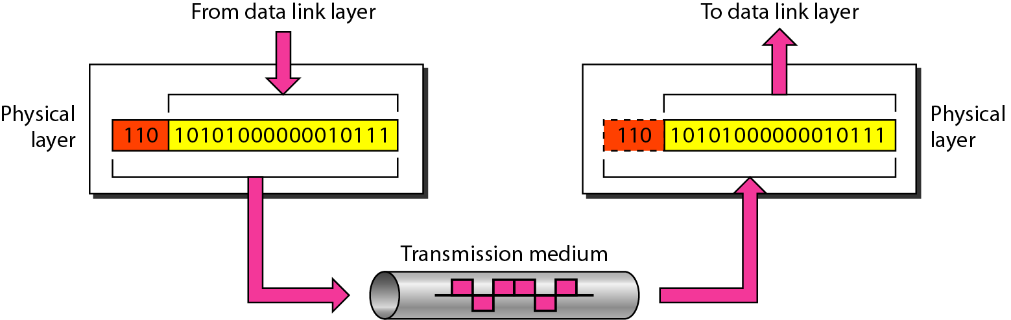
Figure 2.5 Physical layer [1]

Slide 11
Note
The physical layer is responsible for movements of
individual bits from one hop (node) to the next.

Slide 12
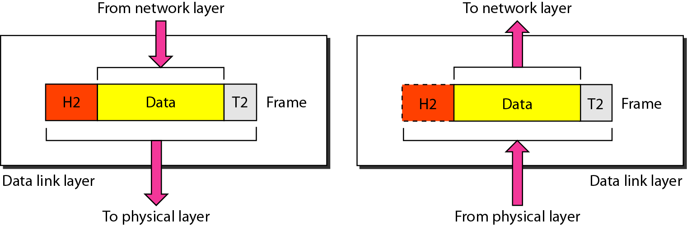
Figure 2.6 Data link layer [1]

Slide 13
Note
The data link layer is responsible for moving frames from one hop (node) to the next.

Slide 14
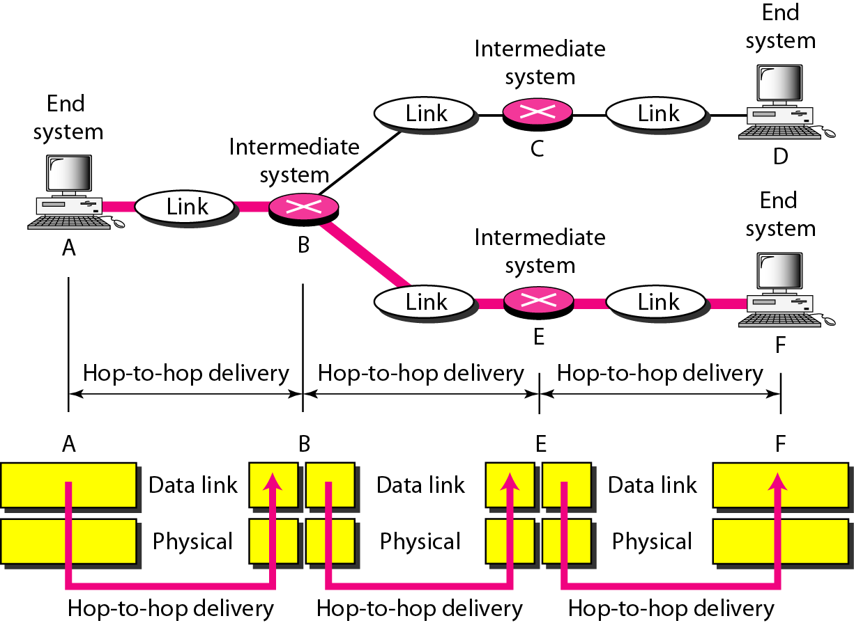
Figure 2.7 Hop-to-hop delivery [1]

Slide 15
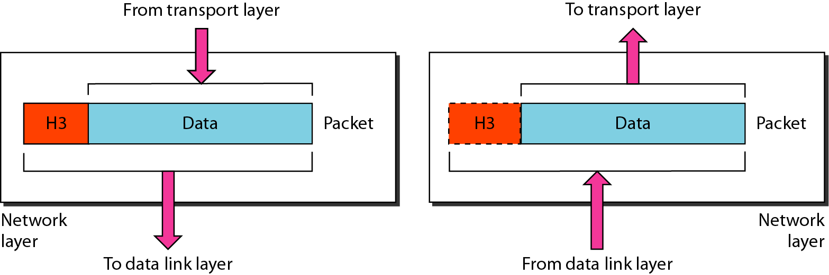
Figure 2.8 Network layer [1]

Slide 16
Note
The network layer is responsible for the delivery of individual packets from
the source host to the destination host.

Slide 17
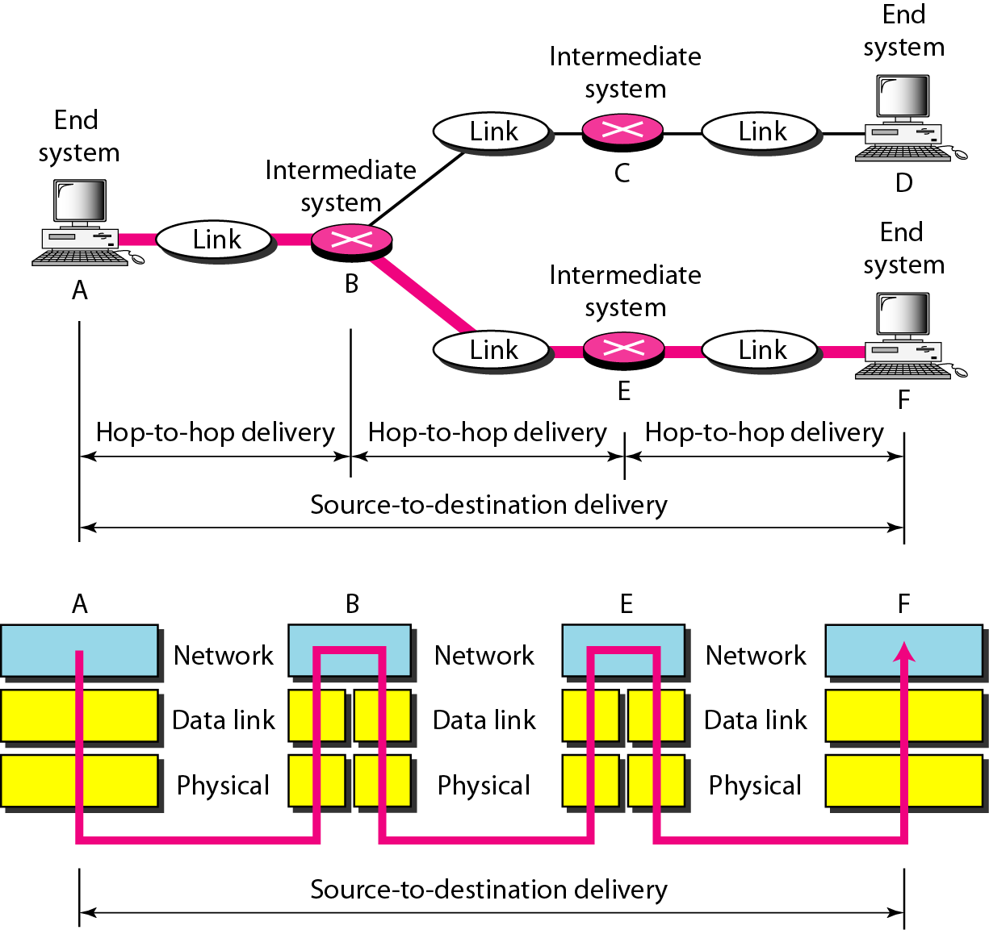
Figure 2.9 Source-to-destination delivery [1]

Slide 18
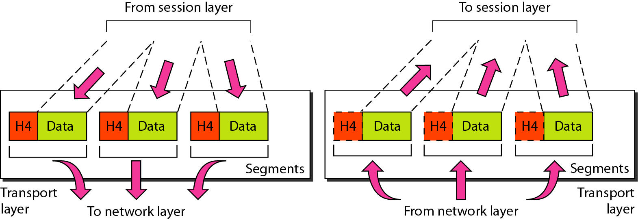
Figure 2.10 Transport layer [1]

Slide 19
Note
The transport layer is responsible for the delivery of a message from one process to another.

Slide 20
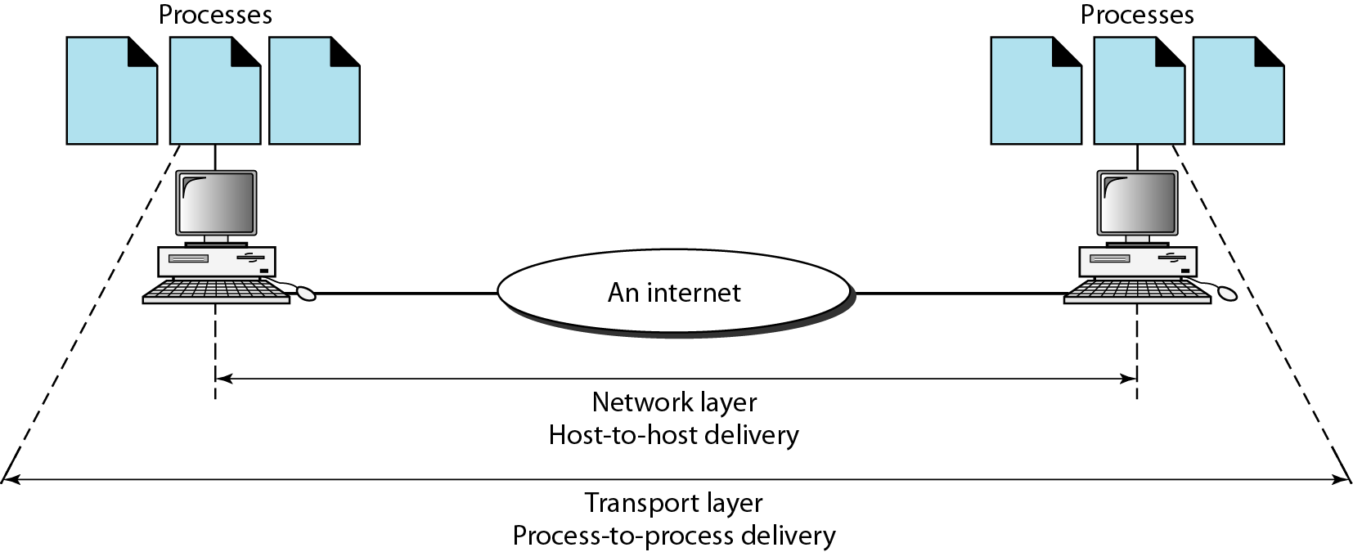
Figure 2.11 Reliable process-to-process delivery of a message [1]

Slide 21
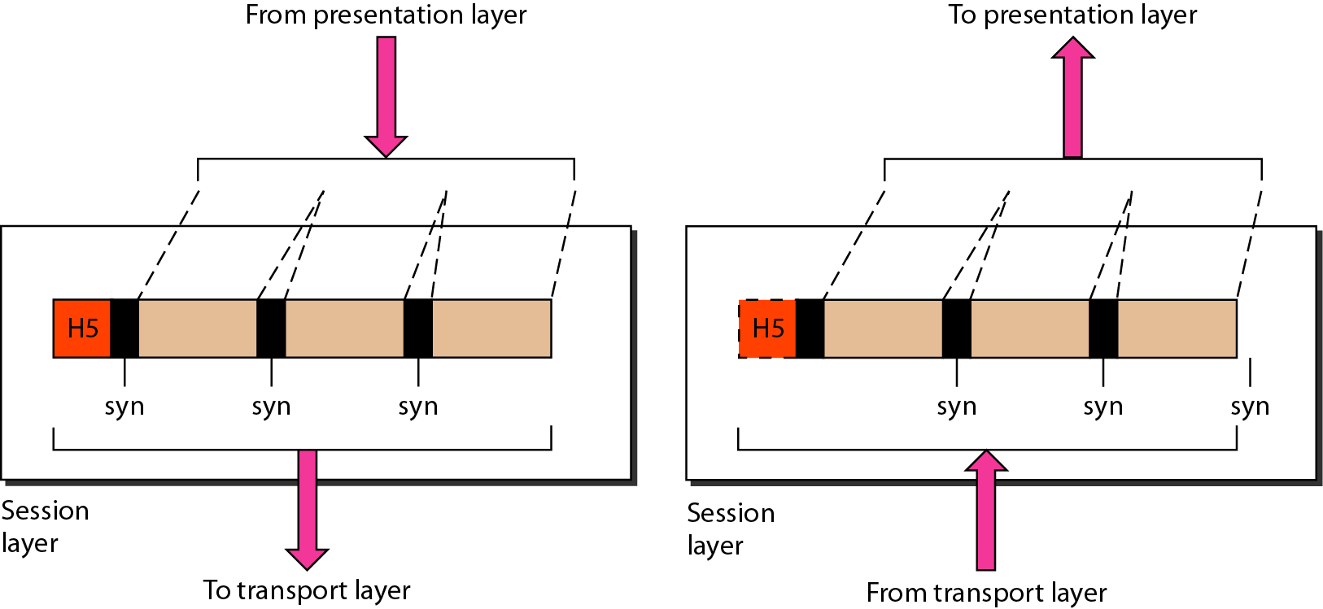
Figure 2.12 Session layer [1]

Slide 22
Note
The session layer is responsible for dialog control and synchronization.

Slide 23
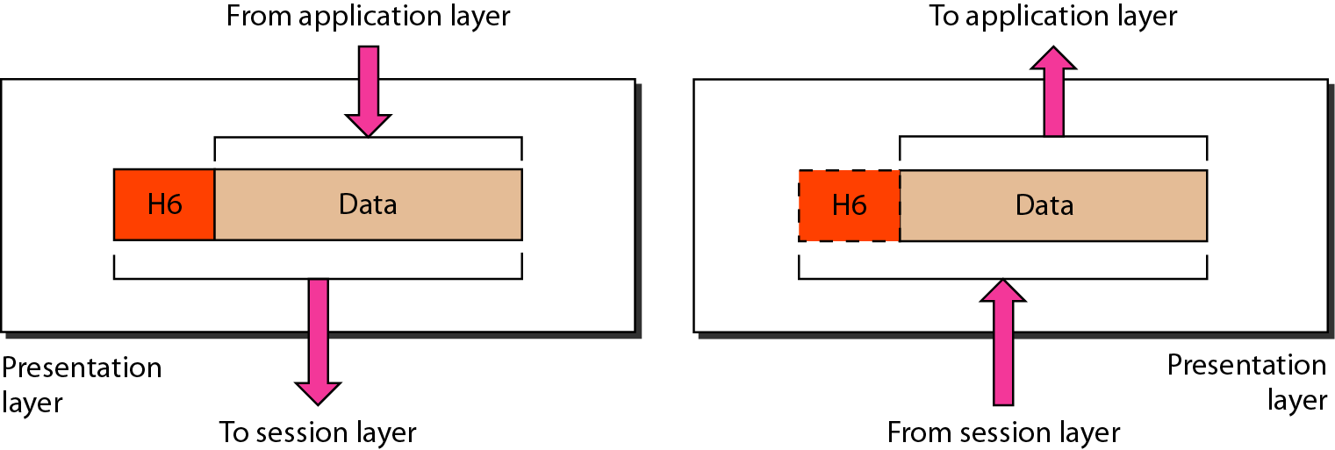
Figure 2.13 Presentation layer [1]

Slide 24
Note
The presentation layer is responsible for translation, compression, and encryption.

Slide 25
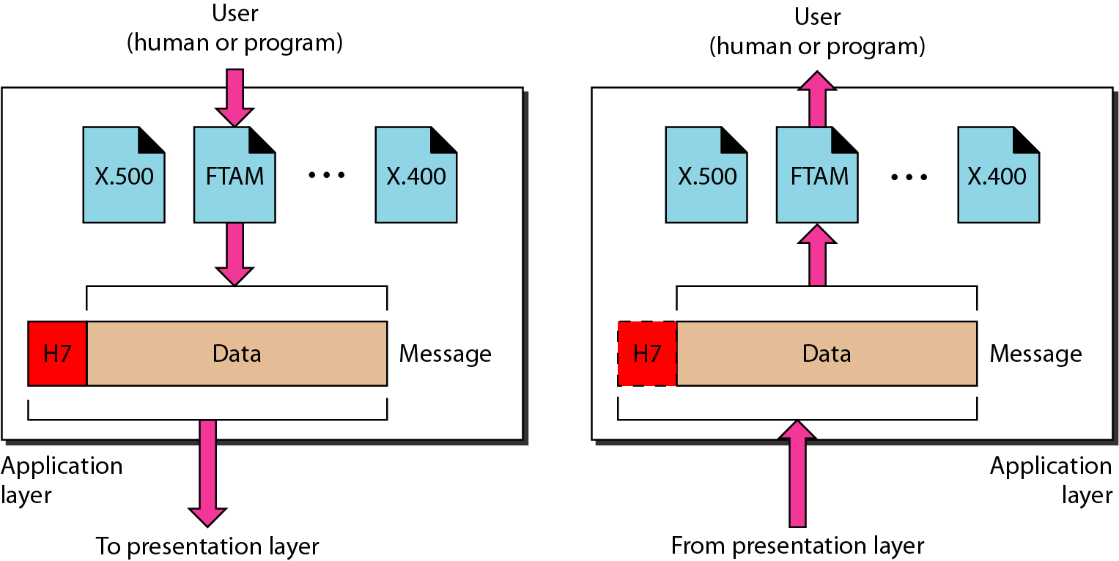
Figure 2.14 Application layer [1]

Slide 26
Note
The application layer is responsible for providing services to the user.

Slide 27
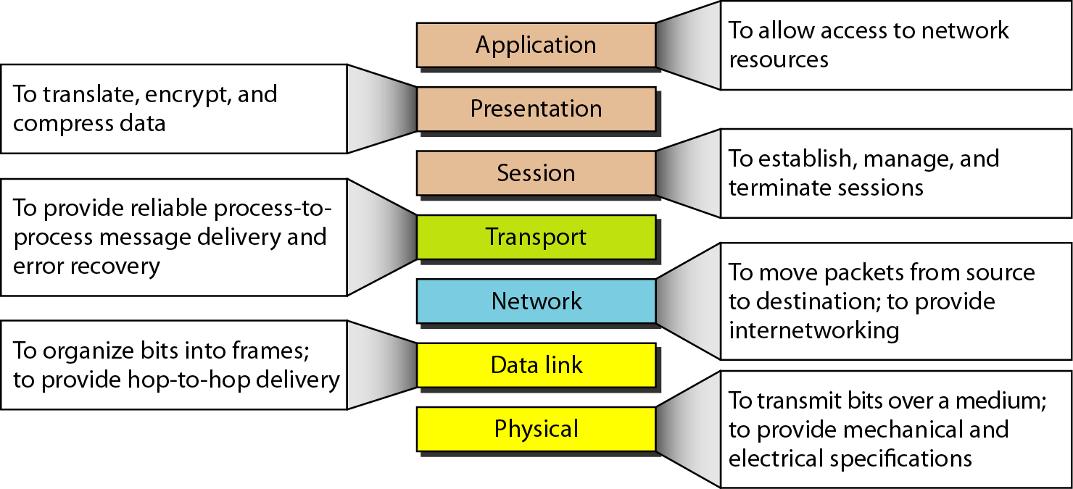
Figure 2.15 Summary of layers [1]

Slide 28
2-4 TCP/IP PROTOCOL SUITE
The layers in the TCP/IP protocol suite do not exactly match those in the OSI model. The original TCP/IP protocol suite was defined as having four layers: host-to-network, internet, transport, and application. However, when TCP/IP is compared to OSI, we can say that the TCP/IP protocol suite is made of five layers: physical, data link, network, transport, and application.
Topics discussed in this section:
Physical and Data Link Layers Network Layer Transport Layer
Application Layer

Slide 29
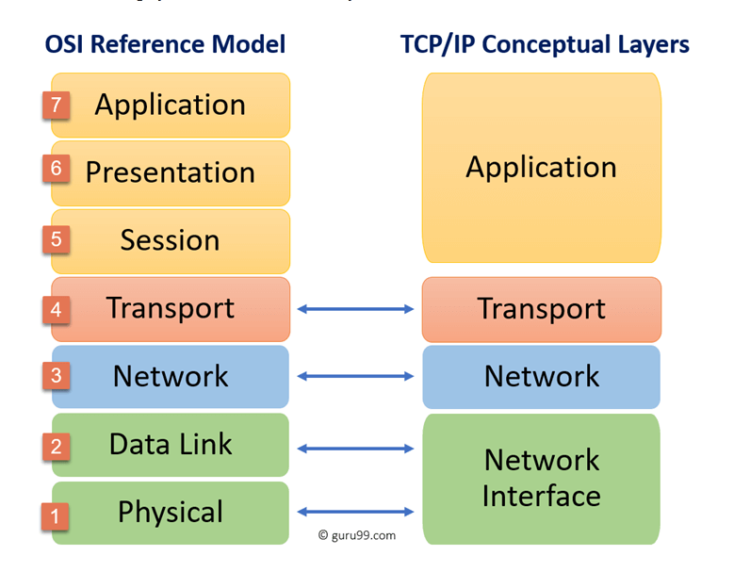

Slide 30
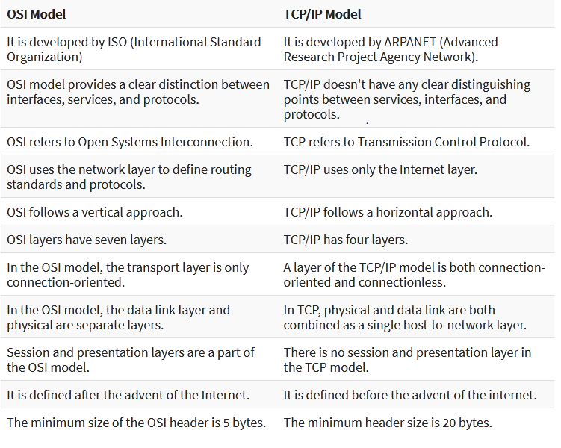

Slide 31
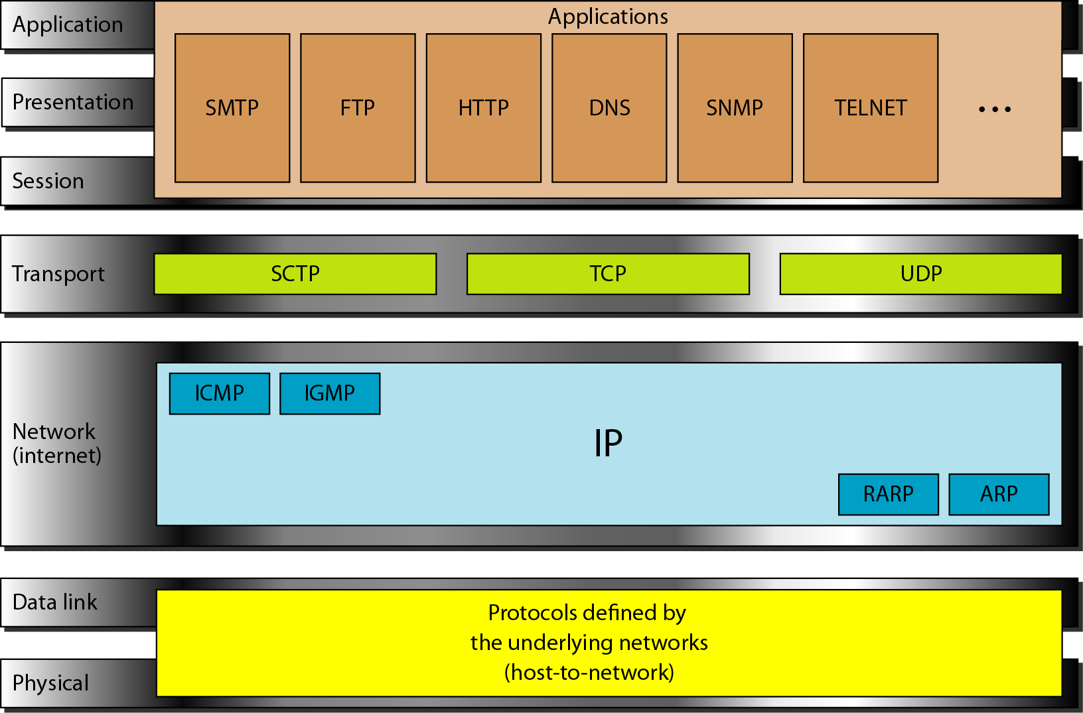
Figure 2.16 TCP/IP and OSI model [1]

Slide 32
References:
Textbooks
[1] Forouzan, Behrouz A.: “Data Communications & networking”, 4th edition TataMcgraw Hill.
[2] Tanenbaum, Andrew S: “Computer networks”, 4th Edition, Pearson education.
Reference books
[3] Stallings, William : “Data and computer communications”,8th edition,Pearson
Education.
[4]Ross, Kurose,“Computer Networking: A top down Approach”, 2nd edition, Pearson
Education.
[5] Coomer,Douglas E.: “Internet working with TCP/IP” , 2 nd edition, Pearson Education
[6] Dave,” Computer Networks, Cengage Learning.
Links:
http://eti2506.elimu.net/Introduction/Books/Data%20Communications%20and%20Networking%20By%20Behrouz%20A.Forouzan.pdf

